Slide 1
IPL Match Winner Prediction Using Machine Learning
NAME: Gowtham K

Slide 2
INTRODUCTION
Overview of the Problem:
The project focuses on predicting the winner of IPL cricket matches using machine learning techniques.
The aim is to use historical match data to create a reliable prediction system that identifies the probable winner of a match.
Brief Explanation Of The Dataset:
Dataset includes key features such as season, teams, toss details, match result, and venue.
Data is processed and analyzed using Python libraries like Pandas, NumPy, Matplotlib, and Seaborn.
The dataset provides both numerical and categorical features, suitable for supervised learning.
Objective of the Project:
To preprocess and analyze the IPL dataset.
To build predictive models using algorithms like Logistic Regression, SVM, KNN, Decision Tree, Random Forest, and XGBoost.
To evaluate performance using metrics such as accuracy, precision, recall, and F1-score.
To tune hyperparameters and select the best-performing model for prediction.

Slide 3
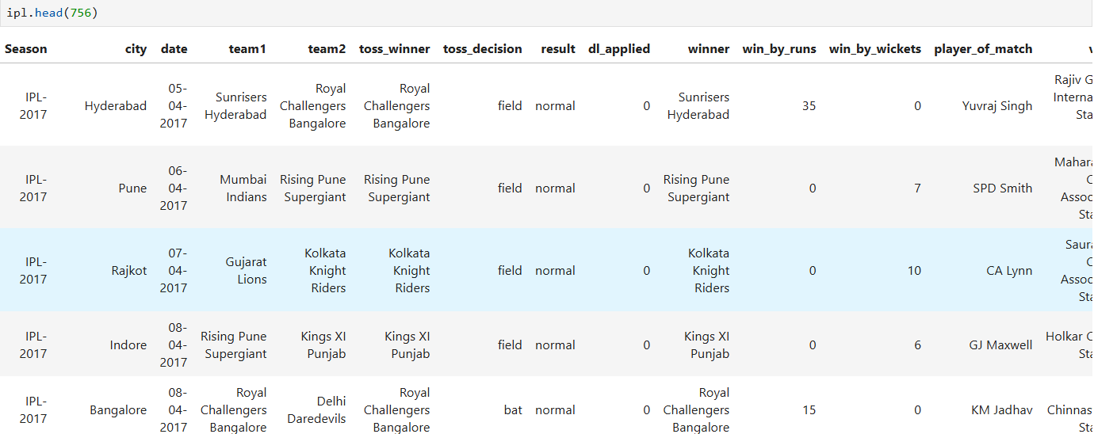
DATA UNDERSTANDING
The dataset contains historical IPL match details.
Key columns include:
Season – The year of the IPL season.
Team1 & Team2 – Competing teams.
Toss Winner – The Team winning the toss.
Toss Decision – Whether the toss winner chose to bat or field.
Venue – Stadium where the match was played.
Winner – Team that won the match.
Player of the Match – Best-performing player.
Win By Runs / Wickets – Margin of victory.
Date – Date when the match took place.

Slide 4
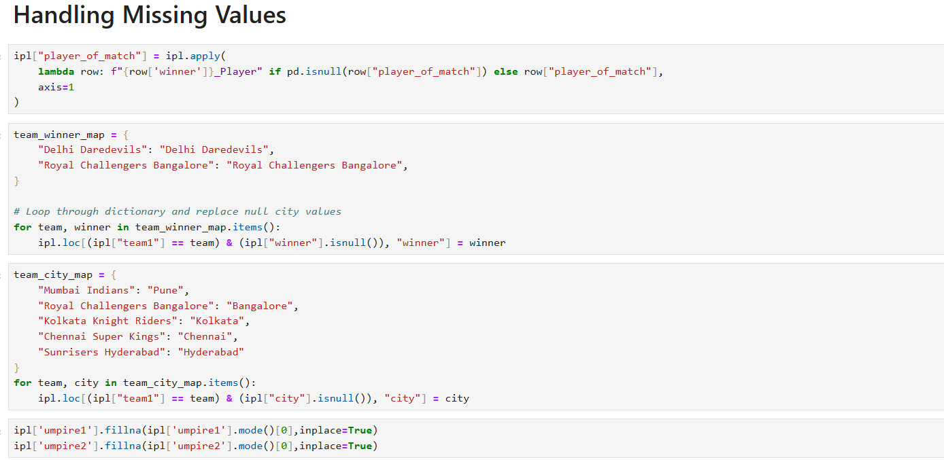
Data Cleaning
Steps Taken:
Converted date column into standard format (YYYY-MM-DD).
Standardized team names.
Removed duplicates, if any.
Handling Missing Values:
Filled missing player of match values with "Winner Player".
Checked for null values in critical columns (teams, season, venue, winner).
KEY INSIGHTS:
Instead of dropping rows with missing values, logical replacements are applied.
Domain knowledge (team–city mapping, winner mapping) is used to fill missing data.
This approach improves dataset quality and model reliability without losing information.
Ensures categorical and textual columns are complete before encoding for ML.

Slide 5
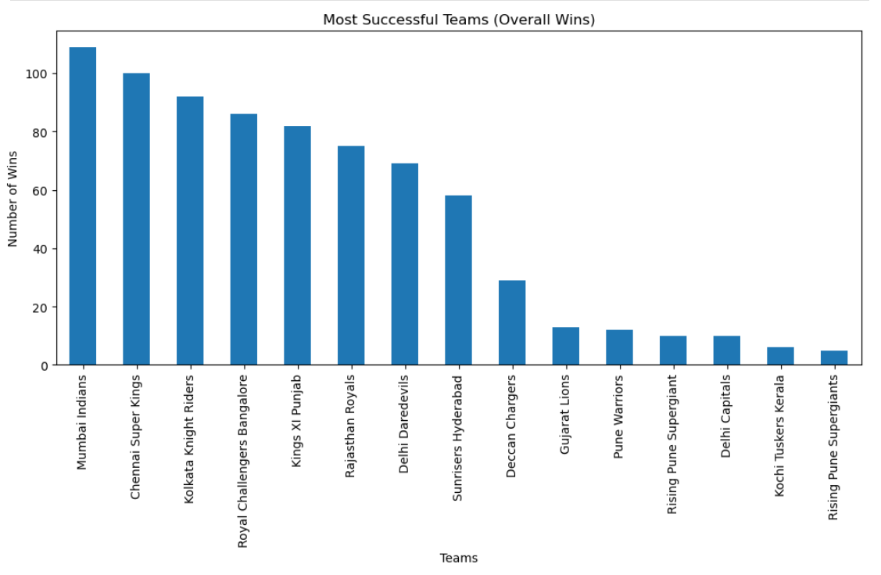
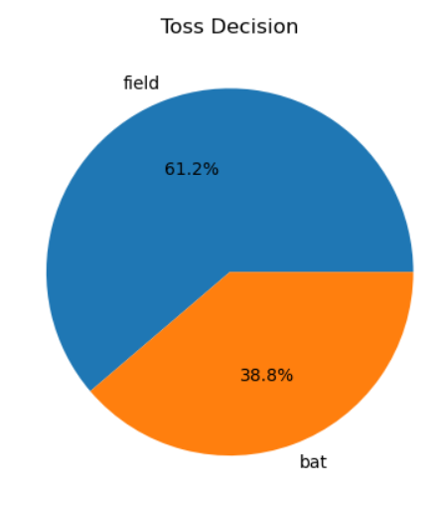
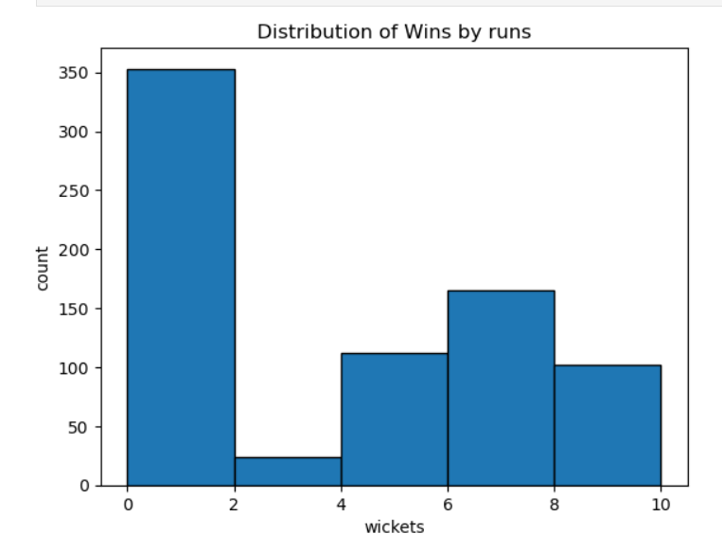
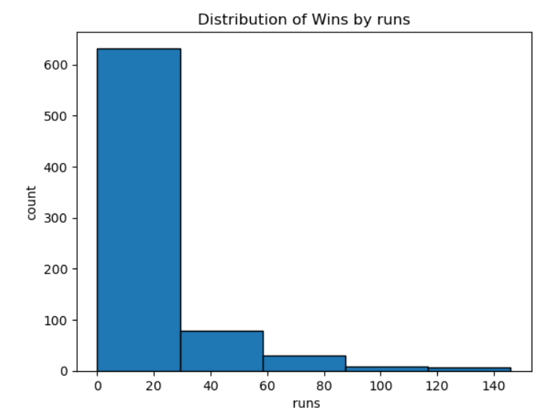
Exploratory Data Analysis (EDA)
Key Insights from EDA
Most Successful Teams:
Mumbai Indians, Chennai Super Kings, and Kolkata Knight Riders are among the top-performing teams with the highest overall wins.
Toss Decisions:
Teams prefer to field first (61.2%) rather than bat first (38.8%), highlighting the advantage of chasing.
Wins by Wickets:
A majority of matches are won with all 10 wickets intact or small margins (6–8 wickets), indicating dominance in some games.
Wins by Runs:
Most matches are won by small run margins (under 20 runs), suggesting that run-defending victories are often close.

Slide 6
Modeling Process
Input Data
Models
Hyperparameter tuning
Evaluation metrics
Logistic regression
SVM
KNN
Decision trees
Random forest
Xgboost
Grid Search
Random Search
Accuracy
Confusion Matrix
Precision
Recall
F1 Score.

Slide 7
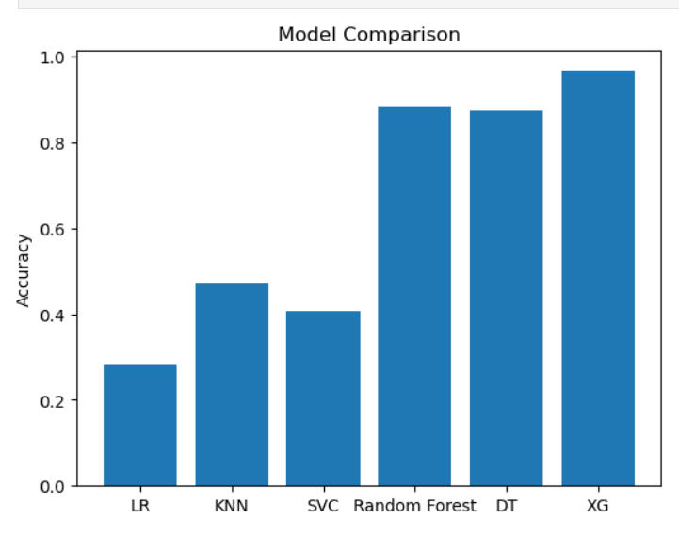

Model Comparison
Performance Comparison of Each Model
🔑 Insights for Model Selection
Best Performing Model → XG Boost (XG)
Achieves the highest accuracy (~0.97–0.98) compared to all other models.
Consistently strong in handling both linear and non-linear relationships, and effective for structured/tabular datasets.
Other High Performers → Random Forest & Decision Tree
Both models reach ~0.87–0.89 accuracy, showing strong performance but slightly below XG Boost.
Random Forest performs better than a single Decision Tree due to ensemble averaging (reduces overfitting).
Moderate Performance → KNN & SVC
KNN reaches ~0.47 accuracy, which is better than Logistic Regression but still relatively low.
SVC is around ~0.41 accuracy, indicating poor generalization for this dataset.
Weakest Model → Logistic Regression (LR)
Performs the worst (~0.29 accuracy).
Likely due to the dataset being non-linear and complex, making linear models unsuitable.
XG Boost

Slide 8
Conclusion
Model Improvement:
Tune hyperparameters (Grid Search, Random Search, Bayesian Optimization)
Apply feature engineering (handling missing values, feature scaling, encoding techniques)
Use cross-validation to avoid overfitting and ensure robust evaluation
Balance dataset ( SMOTE/ undersampling/ oversampling if imbalanced)
Explore ensemble techniques (Stacking, Bagging, Boosting variations)
Future Steps:
Collect more high-quality data for better training
Deploy the best-performing model (XG Boost) into a real-time system
Monitor model performance over time (drift detection)
Implement explainability (SHAP, LIME) for interpretability
Experiment with deep learning models if the dataset size increases

Slide 9


Q&A Slide:
Open floor for any questions

Slide 10
THANK YOU

